Slide 1
Achieving an equal future Post Pandemic
Un-Apologetic Me
Women in Leadership
Un-Apologetic Me
Notes:
Reference: https://www.catalyst.org/research/women-in-management/ Publish Date Aug 2020

Slide 2
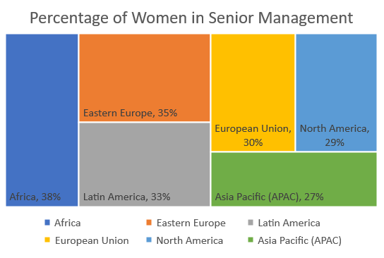
Grinding Halt
2020, the increase percentage of Women representation in Senior Management that we witness in 2019, came to a grinding halt. It stayed as 29% in 2020.
1
2
Notes:
Grant Thornton, Women in Business 2020: Putting the Blueprint into Action (2020): p. 4.
International Labour Organization, Women in Business and Management: The Business Case for Change (2019): p. 44-45.
Grant Thornton, Women in Business 2020: Putting the Blueprint into Action (2020): p. 5.

Slide 3
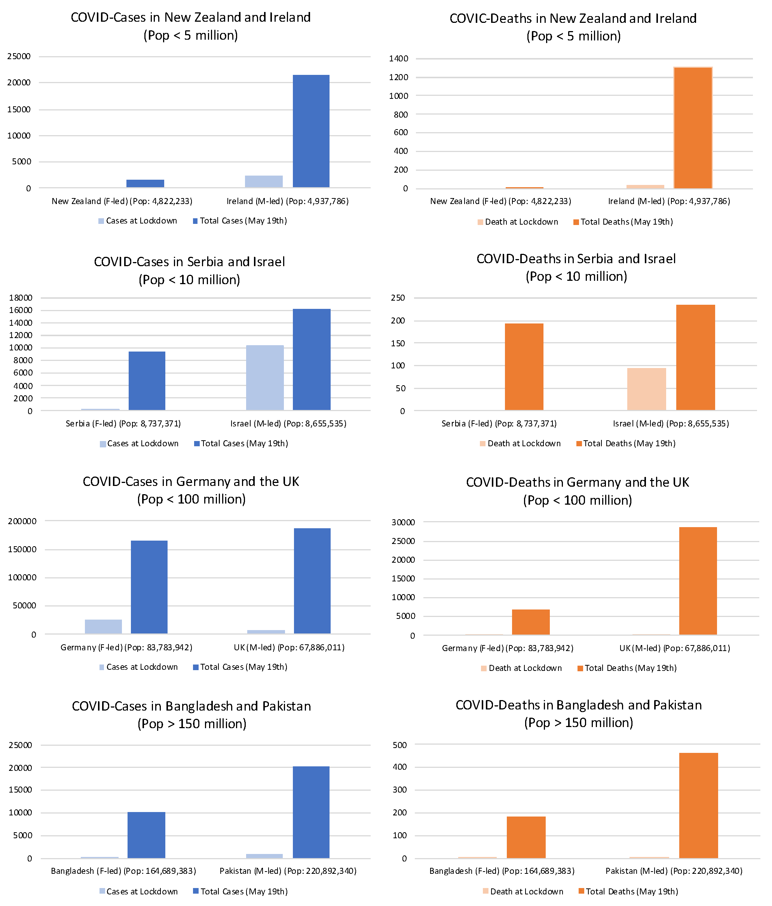
Are Women bad leaders?
Organizations with greater gender balance have been found to outperform male-dominated ones by almost 2% on average each year in non-crisis settings. In Crisis as we see in world domain women leaders are exceling.
Pandemic has shown that Women are better leaders in managing such a crisis – Apple to Apple comparison between men and women leaders.
India Has the Third-Lowest Global Representation of Women Managers, Ahead of Only South Korea and Japan
In 2019, women held only 8% of management roles, 9% of business management roles, and were only 2% of CEOs in India.
Notes:
After consulting a variety of sources, you will need to narrow your topic. For example, the topic of internet safety is huge, but you could narrow that topic to include internet safety in regards to social media apps that teenagers are using heavily. A topic like that is more specific and will be relevant to your peers. Some questions to think about to help you narrow your topic:
What topics of the research interest me the most?
What topics of the research will interest my audience the most?
What topics will the audience find more engaging? Shocking? Inspiring?

Slide 4
Unique aspect of Female Leadership.
What Stands in her Way
Childhood Conditioning
Discrimination
Conscious & Unconscious Bias
Motherhood
Acceptance on Incorrect
Social Structure
Gender differences in risk aversion
Women leaders tend to adverse risk with regard to lives. They are prepared to higher risks with their economies. This is why they brought in lockdown early.
Gender difference in leadership style
Women tended to adopt a more democratic and participative style. Evidence also suggests that good communications skills are important for women to be chosen as leaders and that this is one of the key attributes in managing a crisis
Notes:
Now, that you have narrowed your topic, you will want to organize your research in a structure that works. There are some common organizational patterns based on the kind of research you are doing.
Organizational Structures:
Cause and Effect- this kind of structure is great for explaining the causes and effects of a topic
Compare and Contrast- in this pattern you highlight the similarities and differences of the topic
Explain process- this structure is great for outlining a series of steps to follow;
Definition- if you want to make sure your audience understands what something is using illustrations, meanings, clarifying misconceptions, you may want to use this structure
Classification- a common organizational structure is grouping like topics or facts from the research together. For instance, in the internet safety about social media apps, you may organize the research where you look at each social media app one at a time

Slide 5
Slide 3
Women who negotiate are 30% more likely than men who negotiate to receive feedback that they are "intimidating," "too aggressive," or "bossy" — and they are 67% more likely than women who don't negotiate at all to receive the same negative feedback - 2016 McKinsey study
Why the In-Equality?
Women don’t negotiate for raise or for promotion. Women are typically projected and expected to be shy, coy, nurturing, giver, and collaborator. The role that she plays as a mother is extended in other sphere of her life where she is expected to show similar traits. Asking for what she needs either labels her bossy or self-absorbed
34K employees were surveyed, less than half of the women surveyed said they felt that their contributions are appropriately valued, compared to 54% of the men; and 33% of women said they felt their gender would make it harder for them to get a raise, promotion, or chance to get ahead — 12% of men surveyed said they felt this way.
- 2016 McKinsey & Lean study
Notes:
The reason for this disparity is not that women aren't negotiating — in fact, women negotiate for promotions and raises more often than men do. The hard truth is that, when women negotiate, people like them less for it.
According to the 2016 McKinsey study, women who negotiate are 30% more likely than men who negotiate to receive feedback that they are "intimidating," "too aggressive," or "bossy" — and they are 67% more likely than women who don't negotiate at all to receive the same negative feedback.

Slide 6
Slide 3
Experimental studies of gender in hiring found that "men were preferred for male-dominated jobs whereas no strong preference for either gender was found for female-dominated or integrated jobs.
Difference is higher in sectors with male & female dominated jobs. Women are being paid less for a job of equal value in careers dominated by women.
Why the In-Equality?
Women are natural caregiver. Her strength as multi-tasker, efficient co-Ordinator often lands her up with more of responsibility in unpaid work, especially at home.
In Work From Home, women are disproportionately taking on their own work plus most of the childcare, cooking and housework
Soft work like planning events generally fall on women. It could be due to lack of nomination from men who tend to take these work as distraction or not apt for them. These do take some bit of the focus of women and paints then in little lesser serious towards career tone.
A persistent bias is seen when high achieving men are brought back to work than equally high performing women, in a ration 2:1
Notes:
The reason for this disparity is not that women aren't negotiating — in fact, women negotiate for promotions and raises more often than men do. The hard truth is that, when women negotiate, people like them less for it.
According to the 2016 McKinsey study, women who negotiate are 30% more likely than men who negotiate to receive feedback that they are "intimidating," "too aggressive," or "bossy" — and they are 67% more likely than women who don't negotiate at all to receive the same negative feedback.

Slide 7
Slide 3
Why the In-Equality?
India as one of the bottom 10 countries on its list. In addition to unequal pay, there is also unequal representation, because while women constitute almost half the Indian population (about 48% of the total), their representation in the work force amounts to only about one-fourth of the total
Motherhood – traditionally, women leave the workforce temporarily during maternity or a bit later to take care of their children.
They opt and comprise on salary for more flexible and less demanding jobs compared to higher-paying jobs.
According to Martell, Richard F.; et al. in "Sex Stereotyping In The Executive Suite: 'Much Ado About Something'". Journal of Social Behavior & Personality, women in middle management are perceived to lack the courage, leadership, and drive that male managers appear to have,[56] despite female middle managers achieving results on par with their male counterparts in terms of successful projects and achieving results for their employing companies.
Notes:
The reason for this disparity is not that women aren't negotiating — in fact, women negotiate for promotions and raises more often than men do. The hard truth is that, when women negotiate, people like them less for it.
According to the 2016 McKinsey study, women who negotiate are 30% more likely than men who negotiate to receive feedback that they are "intimidating," "too aggressive," or "bossy" — and they are 67% more likely than women who don't negotiate at all to receive the same negative feedback.

Slide 8
Change Starts from Us – At Home
Begin from Home
Take care of yourself
Ensure to prioritize yourself and your work
Talk & Express your needs
Create a List in your household what needs to be done and how to divide this work.
Divide the work equally
In families with children, make sure to have similar access and restrictions and division of work
Notes:
After you’ve done your research, it’s time to put your presentation together. The first step in the process is to introduce the topic. This is a great time to connect your topic to something that your audience can relate. In other words, why should they listen to all the information you will be sharing in your research presentation? What is in it for them? You may also want to include a graphic or image to grab their attention.
Feel free to duplicate this slide by right-clicking on this slide in the slides pane to the left and select Duplicate Slide.
The next step in your presentation is to state your claim or topic clearly. Your teacher may even call this your thesis. As you state your thesis, you may find that this layout is not the best layout for your claim or topic. You can change the layout by clicking the drop-down menu next to the Layout in the Slides menu section. You can choose Two Content, Comparison, or Picture with Caption. Note: A different layout might change the look of the icons on this page.
You will also want to state your facts. You have done the research now share some of the interesting facts with your audience. Facts do not have to be boring; you can communicate facts in a variety of ways by going to the Insert Tab. In the Insert tab you can:
Insert pictures from your computer or online.
Add a chart
Create some SmartArt
Insert a variety of icons to help your facts come to life. Note: You can change the color of the icons by selecting the icon and then click on the Format tab and then Graphics Fill. From there, you will choose a color from the list or choose More Fill Colors to give you more options.
Since this research presentation is a result of your hard work and searching, you want to make sure you support the claims or points in your presentation with facts from your research findings. Make sure you give the author proper credit for helping you share your ideas. If one of your sources has a video that is relevant to your topic, you can add the video as added support. Keep in mind the length of the video and the amount of time you have for your presentation. For a 5 minute speech, the video should be no longer than 30 seconds.
Questions to consider:
How will you state the author of the source?
Will you need to cite the source on the slide?
What are some ways you can engage your audience so they feel like they are a part of the presentation? Some ideas to consider is by taking a quick poll like: by a show of hands, how many of you think school uniforms are a way to cut down on bullying? Another suggestion is to have them hold up a certain number of fingers to see if they agree or disagree. Finally, you can share a story that the audience can relate to that makes them laugh.
After all the applause, your audience may have some questions. Be prepared to answer some of their questions by making a list of questions you think they might ask. You may also want to share the presentation with them by providing the link to your presentation, if they want more information.

Slide 9
Change Starts from Us – At Office
Be cognizant of Halo Effect & Horn Effect
Charms or Charisma is not Efficiency
Gender Bias - an assertive woman might be perceived as “aggressive” while a man with the same attributes might be described as “confident.”
Evaluate both on similar scale. Ask why and what did you find aggressive ,is it because it breaks the image you had growing up
Similarity Bias - Prefer hiring candidates who’ve worked at specific streams
The risk here is of groupthink
Confirmation Bias - look for information that confirms our beliefs and overlook information that goes against them.
Disastrous New Coke is the best example
Notes:
After you’ve done your research, it’s time to put your presentation together. The first step in the process is to introduce the topic. This is a great time to connect your topic to something that your audience can relate. In other words, why should they listen to all the information you will be sharing in your research presentation? What is in it for them? You may also want to include a graphic or image to grab their attention.
Feel free to duplicate this slide by right-clicking on this slide in the slides pane to the left and select Duplicate Slide.
The next step in your presentation is to state your claim or topic clearly. Your teacher may even call this your thesis. As you state your thesis, you may find that this layout is not the best layout for your claim or topic. You can change the layout by clicking the drop-down menu next to the Layout in the Slides menu section. You can choose Two Content, Comparison, or Picture with Caption. Note: A different layout might change the look of the icons on this page.
You will also want to state your facts. You have done the research now share some of the interesting facts with your audience. Facts do not have to be boring; you can communicate facts in a variety of ways by going to the Insert Tab. In the Insert tab you can:
Insert pictures from your computer or online.
Add a chart
Create some SmartArt
Insert a variety of icons to help your facts come to life. Note: You can change the color of the icons by selecting the icon and then click on the Format tab and then Graphics Fill. From there, you will choose a color from the list or choose More Fill Colors to give you more options.
Since this research presentation is a result of your hard work and searching, you want to make sure you support the claims or points in your presentation with facts from your research findings. Make sure you give the author proper credit for helping you share your ideas. If one of your sources has a video that is relevant to your topic, you can add the video as added support. Keep in mind the length of the video and the amount of time you have for your presentation. For a 5 minute speech, the video should be no longer than 30 seconds.
Questions to consider:
How will you state the author of the source?
Will you need to cite the source on the slide?
What are some ways you can engage your audience so they feel like they are a part of the presentation? Some ideas to consider is by taking a quick poll like: by a show of hands, how many of you think school uniforms are a way to cut down on bullying? Another suggestion is to have them hold up a certain number of fingers to see if they agree or disagree. Finally, you can share a story that the audience can relate to that makes them laugh.
After all the applause, your audience may have some questions. Be prepared to answer some of their questions by making a list of questions you think they might ask. You may also want to share the presentation with them by providing the link to your presentation, if they want more information.

Slide 10
Change Starts from Us – At Office
Bro-propriating
Group meeting, a female member of the team makes a point that no one seems to feel too strongly about. Thirty minutes later, a male member of the team makes the same point — and everyone jumps on board with “his” idea.
Height Discrimination
Tall employees make anywhere between 9–15% more than their counterparts. It could be the extension of Halo Effect.
Learn what unconscious biases are Take tests
Interact with people different from you
Encourage people to speak up about biases
Read, travel, explore unknown food, take on work with someone different
Hold yourself accountable
You can change the future, if not you then who, if not now then when
Work with People
Understand people do not work for you, and you do not work for people.
Notes:
After you’ve done your research, it’s time to put your presentation together. The first step in the process is to introduce the topic. This is a great time to connect your topic to something that your audience can relate. In other words, why should they listen to all the information you will be sharing in your research presentation? What is in it for them? You may also want to include a graphic or image to grab their attention.
Feel free to duplicate this slide by right-clicking on this slide in the slides pane to the left and select Duplicate Slide.
The next step in your presentation is to state your claim or topic clearly. Your teacher may even call this your thesis. As you state your thesis, you may find that this layout is not the best layout for your claim or topic. You can change the layout by clicking the drop-down menu next to the Layout in the Slides menu section. You can choose Two Content, Comparison, or Picture with Caption. Note: A different layout might change the look of the icons on this page.
You will also want to state your facts. You have done the research now share some of the interesting facts with your audience. Facts do not have to be boring; you can communicate facts in a variety of ways by going to the Insert Tab. In the Insert tab you can:
Insert pictures from your computer or online.
Add a chart
Create some SmartArt
Insert a variety of icons to help your facts come to life. Note: You can change the color of the icons by selecting the icon and then click on the Format tab and then Graphics Fill. From there, you will choose a color from the list or choose More Fill Colors to give you more options.
Since this research presentation is a result of your hard work and searching, you want to make sure you support the claims or points in your presentation with facts from your research findings. Make sure you give the author proper credit for helping you share your ideas. If one of your sources has a video that is relevant to your topic, you can add the video as added support. Keep in mind the length of the video and the amount of time you have for your presentation. For a 5 minute speech, the video should be no longer than 30 seconds.
Questions to consider:
How will you state the author of the source?
Will you need to cite the source on the slide?
What are some ways you can engage your audience so they feel like they are a part of the presentation? Some ideas to consider is by taking a quick poll like: by a show of hands, how many of you think school uniforms are a way to cut down on bullying? Another suggestion is to have them hold up a certain number of fingers to see if they agree or disagree. Finally, you can share a story that the audience can relate to that makes them laugh.
After all the applause, your audience may have some questions. Be prepared to answer some of their questions by making a list of questions you think they might ask. You may also want to share the presentation with them by providing the link to your presentation, if they want more information.

Slide 11
That’s All from Un-Apologetic Me – Naseha
www.Naseha.world
Notes:
You can use this slide as your opening or closing slide. Should you choose to use it as a closing, make sure you review the main points of your presentation. One creative way to do that is by adding animations to the various graphics on a slide. This slide has 4 different graphics, and, when you view the slideshow, you will see that you can click to reveal the next graphic. Similarly, as you review the main topics in your presentation, you may want each point to show up when you are addressing that topic.
Add animation to images and graphics:
Select your image or graphic.
Click on the Animations tab.
Choose from the options. The animation for this slide is “Split”. The drop-down menu in the Animation section gives even more animations you can use.
If you have multiple graphics or images, you will see a number appear next to it that notes the order of the animations.
Note: You will want to choose the animations carefully. You do not want to make your audience dizzy from your presentation.

